Slide 1


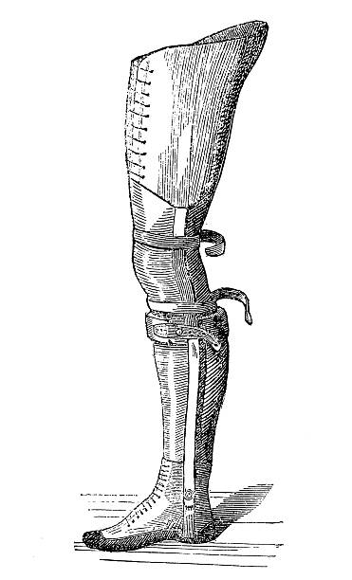
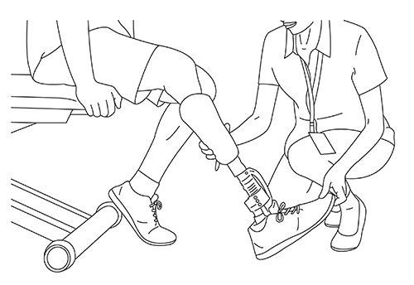

Lower Limb
Amputee Management Course
24 November – 28 November 2025
Online Format
$800.00 Information:
Organiser: Dr Greg Bowring
Greg.Bowring@health.nsw.gov.au
Registration: Please email Cornelia Khaled
Cornelia.Khaled@health.nsw.gov.au
Tel. 02 9382 8599

Slide 2

Payment portal link:
NSW Health Payment Platform

Slide 3
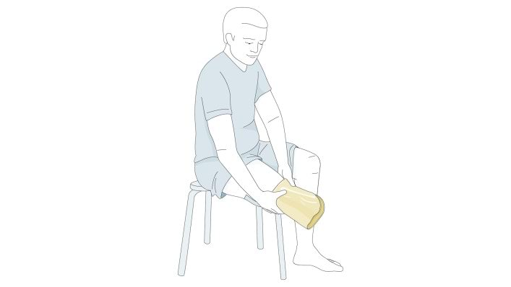
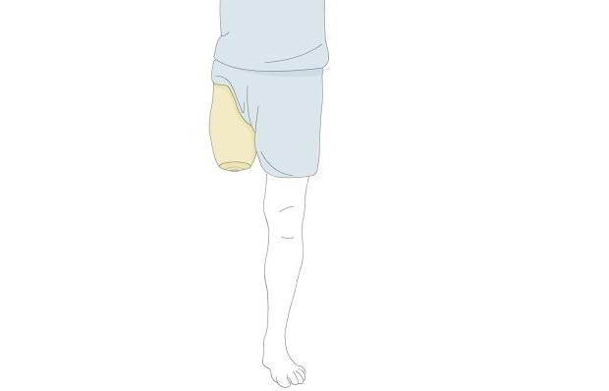
Learning design
Course content
The Course is designed for Allied Health Practitioners, esp Physiotherapists and OTs specialising in amputee care,
AFRM trainees and Rehabilitation Medicine Physicians seeking a refresher.
Includes Limb deficiency/difference in children.
The course is based upon our successful F2F course but uses an on-line format.
Materials supplied in digital format beforehand.
Lecturers available for Q & A during & after every session.
5 days online.
- Surgical aspects
- Assessment for Rehabilitation
- Pain Management
- Psychological aspects
- Biomechanics
- Gait Analysis
- Prosthetic Socket Design
- Alignment Principles
- Prosthetic Components
- Prescription principles
- Prosthetic and Gait Training
- Driving assessment & training
- Amputee sports
- Osseointegration
- Funding Schemes
P R O G R A M
MONDAY TUESDAY WEDNESDAY THURSDAY FRIDAY
REGISTRATION
An introduction to Lower Limb Amputation and Prosthetics
Principles of Normal Gait
Gait Practical
Assessment for Rehabilitation
Measuring Outcomes – Amputees Rehabilitation
Amputation and Vascular surgery
Early post-op management incl RRD fabrication
Driving assessment
Biomechanics of the transtibial prosthesis
Components of partial foot & transtibial prostheses
Transtibial amputee gait
Gait training for amputees
Prescription principles for partial foot & transtibial prostheses
Check-out procedure for the
transtibial prosthesis
Cases for prescription for transtibial prosthesis
Biomechanics of the transfemoral and knee disarticulation prosthesis
Components of transfemoral and knee disarticulation
Transfemoral Amputee Gait
Prescription principles for the transfemoral and knee disarticulation
Cases for prescription of transfemoral prosthesis
Check-out of transfemoral prosthesis
The Artificial Limb Schemes in Australia
Evidence based pain management
Amputee pain cases
Psychological effects of amputation
The Child with limb deficiency
Paediatric cases
Helping amputees maximise independence
Osseointegration and powered prostheses
Components of hip
disarticulation prostheses
Gait training hip disarticulation transpelvic amputee
Sporting lower limb prostheses training for sport
Quiz
Clinic Presentations

